Slide 1
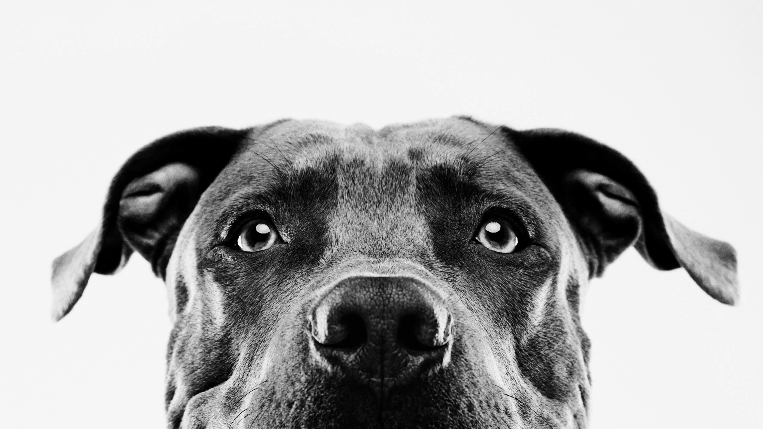
Project 1: Animal Shelter Analysis
Rumpelstiltskin and The Ladies “ Squad a”
March 6, 2021

Slide 2
Project 1 – Rumpelstiltskin and the ladies (AKA Squad A)
Project Description
Analyzing the data from the Bloomington, IN animal shelter to determine the most common types of animals in the shelter and identify any adoption trends.
Members
Rumpelstiltskin “Richard Moseley”
Jessica Dean
Rebecca Stilley
Brook Forrester
Stacey Boyce

Slide 3

Project 1: the journey
determining the topic and Finding the data

Slide 4
determining the topic
We tried to find something we all had in common or a topic we would all find interesting. Items we considered were music, gaming, sports, and shows but our pets and our interest in animals in general was the most stimulating for the group.
We discussed questions related to pets, but the sheltering and adoption of animals was something that we thought there would be data available for us to collect.

Slide 5
Finding the data
We found different sites and an API that had data we could use to answer our original questions. The Humane Society has a site with multiple types of information but we did not see an API for the site and the download options were not in formats that we could do our own slicing and dicing. We registered for an API but we did not end up using this since we had started analyzing a dataset we had already found which started to change to scope of our project.

Slide 6
Data Selection
Factors for data selection
The Bloomington, IN data was a robust dataset, it had over 10,000 lines of useable data
We tailored our questions based on the data available.
We chose to use only one dataset because it offered all the informational components for the questions we created after our data discovery.

Slide 7
Information about the dataset
Summary
In early 2017, the Bloomington Animal Shelter migrated management software from AnimalShelterNet to Shelter Manager. We attempted to preserve as much information as possible from the old system. The outcome fields in animal shelter are scattered in multiple fields not just one, for example Dead on arrival, Put to sleep, Movement Type and others are all considered as part of outcome.
Years in the dataset: 2009-2019
Acknowledgements
Source: https://data.bloomington.in.gov/dataset/adopted-animals Last updated at https://data.bloomington.in.gov/dataset : 2020-09-25

Slide 8
Project 1 : the journey Continues
Data clean up and processing

Slide 9
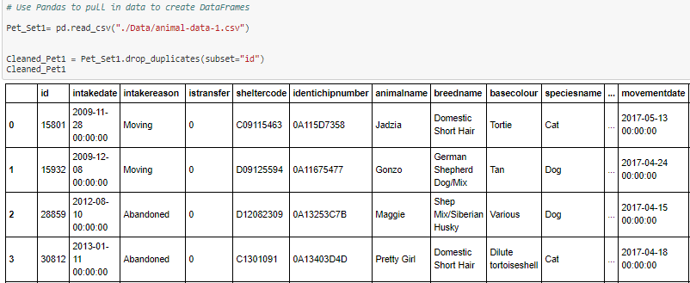
Cleaning the data
In the original dataset we discovered the same animal ID was repeated across multiple rows. We utilized the drop duplicates function to clean our dataset.

Slide 10
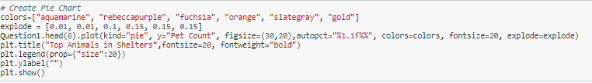
Most common animals in the shelter
We pulled the top 6 species from the dataset to reduce the clutter in the visualization, the counts ranged from 3,870 to 1.
We decided to use a pie chart to easily showcase the vast amount of data that could be grouped.

Slide 11
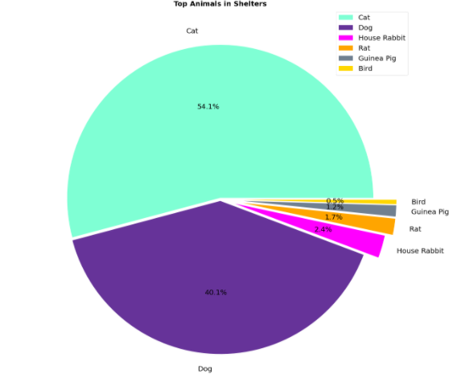
which animals are most common in the animal shelter?

Slide 12
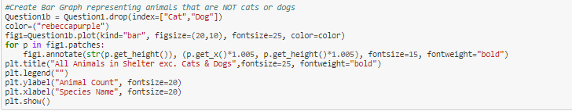
What types of animals end up in the shelter other than cats & dogs?
We used the bar graph to showcase the other animals that this shelter took in after we removed the top 2. The graph gives a visual of the range in the number of other species but also displays the vague groupings of the species. For example, wildlife and livestock.
Due to the range in numbers in the graph, we utilized outside resources to place the count above the bars for better visualization.

Slide 13
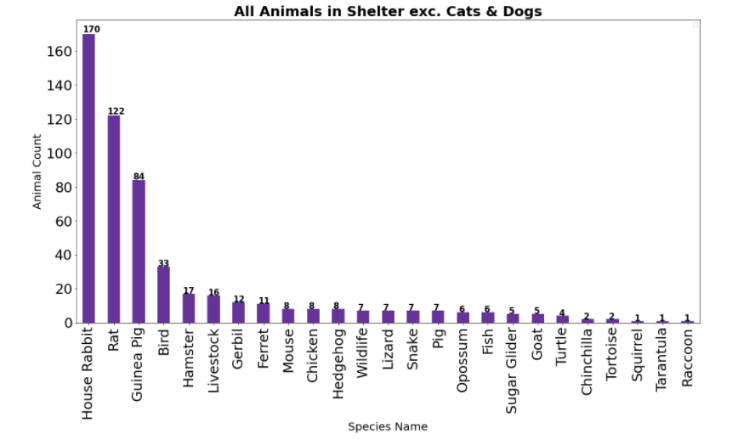
What types of animals end up in the shelter other than cats & dogs?

Slide 14
Ratio of Males to Females in Cats and Dogs in the shelter
By analyzing the data to determine the types of species in the shelter we were able to conclude that cats and dogs are the most common animal in the shelter making up 92.45% of the total animals in the dataset.
With these two species being the most common we went a step further and analyzed the number of cats vs dogs and then gender of the two species.

Slide 15
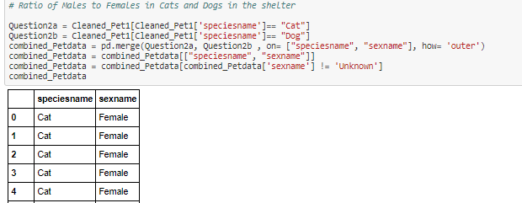
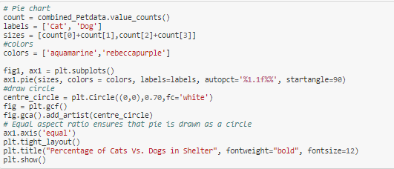
Ratio of Males to Females in Cats and Dogs in the shelter

Slide 16
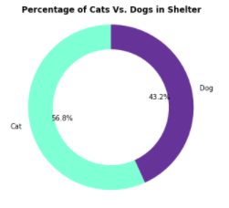
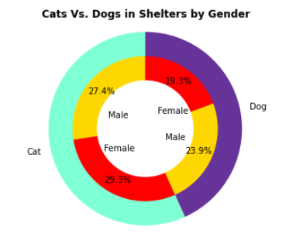
cats and dogs are the most common, what is the Ratio of Males to Females for Cats vs. Dogs in the shelter?

Slide 17
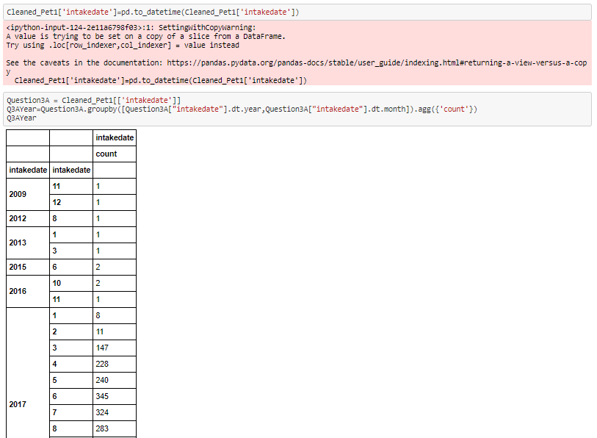
Number of animals in shelter vs adoption ~2009-2019

Slide 18
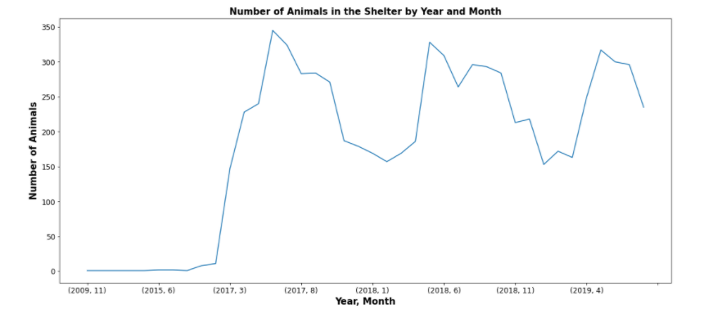
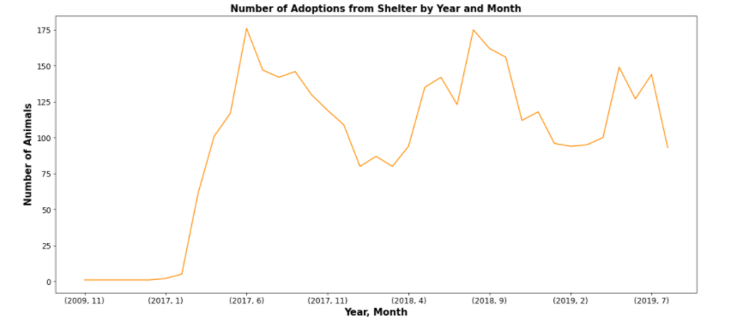

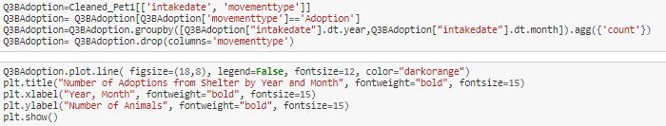
Number of animals and adoptions at the shelter

Slide 19

Combination of plots
Used line graphs to see the volume of animals coming into the shelter and those being adopted over the timeframe of the dataset.
We were able to locate information on how to plot with multiple axis in order to see if the trends for the number of adoptions compared to the number of animals in the shelter.
This dataframe also allowed us to see that we did not have a full 10 years of data and that their data conversion from the old system was not successful.

Slide 20
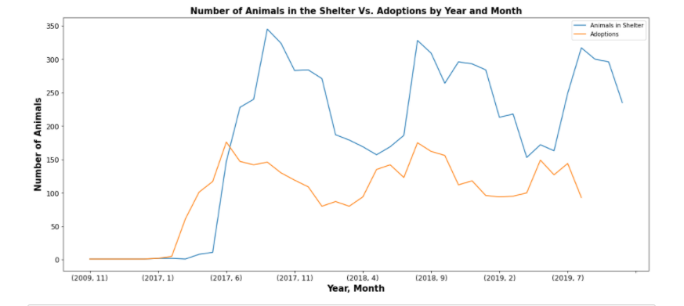
Number of animals and adoptions in the same plot

Slide 21
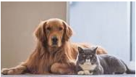

Final observations and Challenges we faced
Throughout the project we were utilizing the CSV file outside of the Jupyter Notebook to help us understand the data in the dataframes narrow down what we needed when creating a new dataframe for each question.
Getting the date column into workable format for grouping for a trend
GitHub Branches

Slide 22

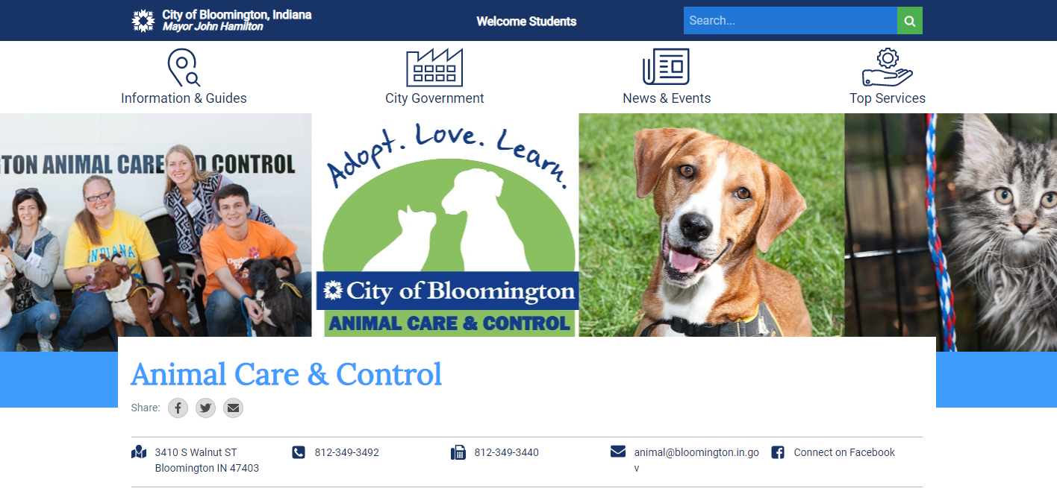
Data Selection: Source
Through kaggle.com we found a dataset from the Bloomington, IN Animal Shelter

